Slide 1

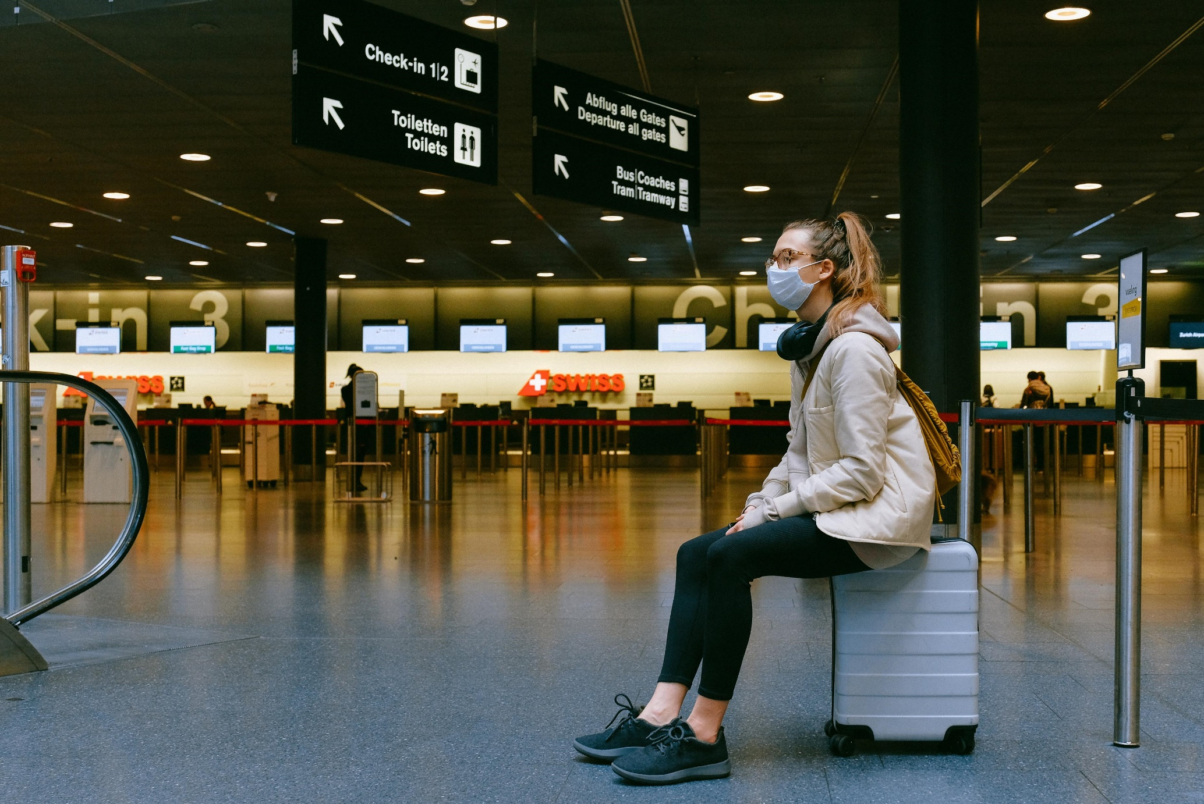

Slide 2
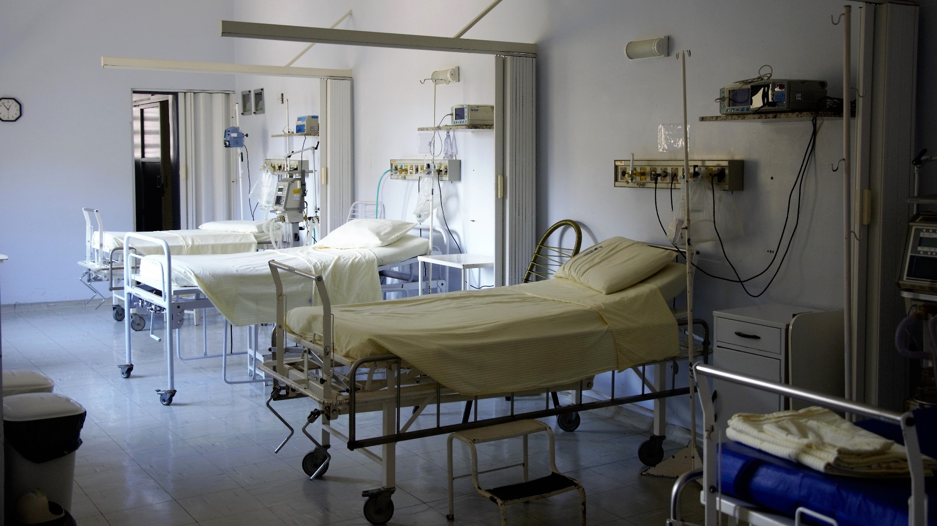
Hospitals create more negative pressure rooms

Slide 3

All nonemergent and elective surgeries and procedures were canceled to free up essential hospital staff and hospital beds.

Slide 4

Obtain PPE and address PPE shortages.

Slide 5

hire a backup workforce.
pay overtime to staff.
educate staff.

Slide 6
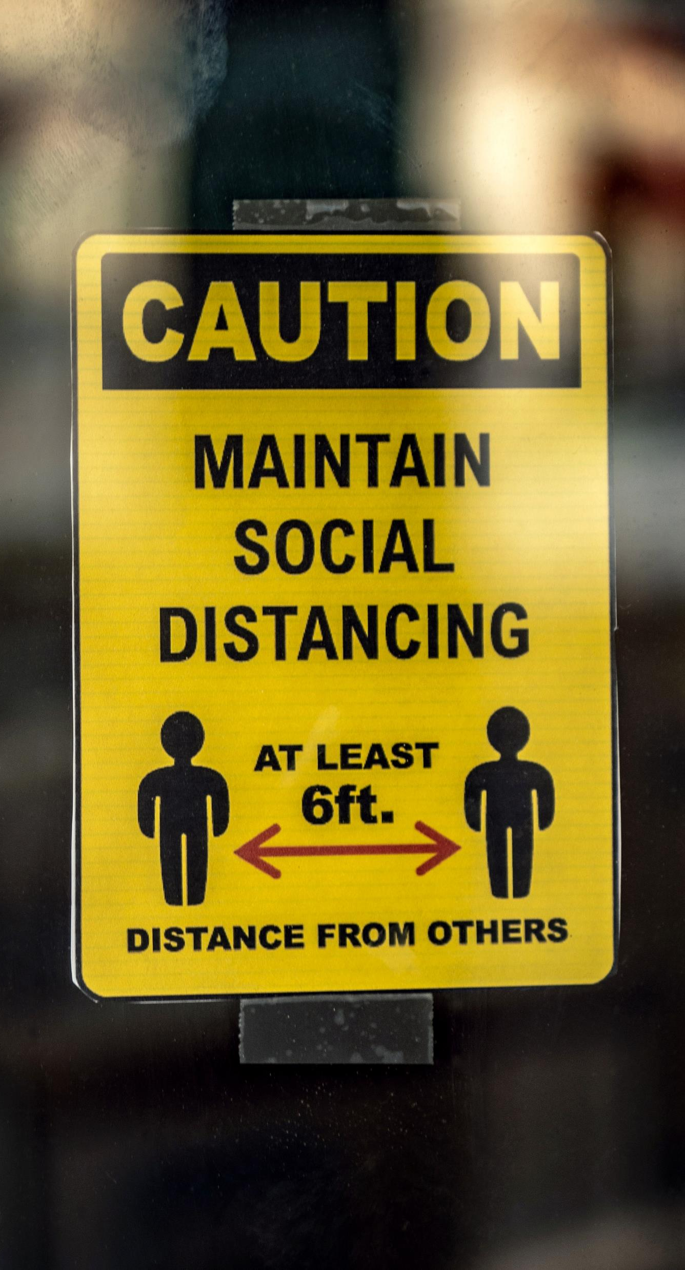

Social distancing practices and patient anxiety related to COVID-19 led to the cancellation of nearly all outpatient appointments and a transition to virtual telemedicine appointments.

Slide 7

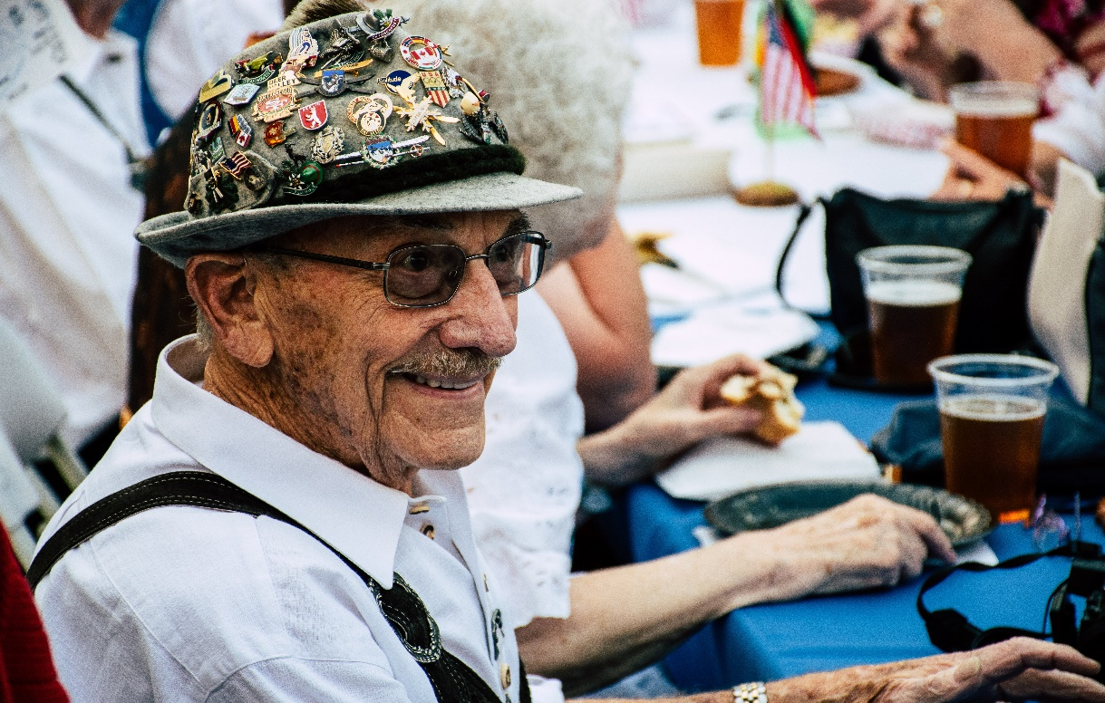
Nursing homes and long-term care facilities have been extremely impacted by COVID-19, with more than 40% of the total deaths related to the pandemic being residents or staff of these facilities. Eight out of ten COVID -19 deaths in the US occur in individuals older than 65.

Slide 8
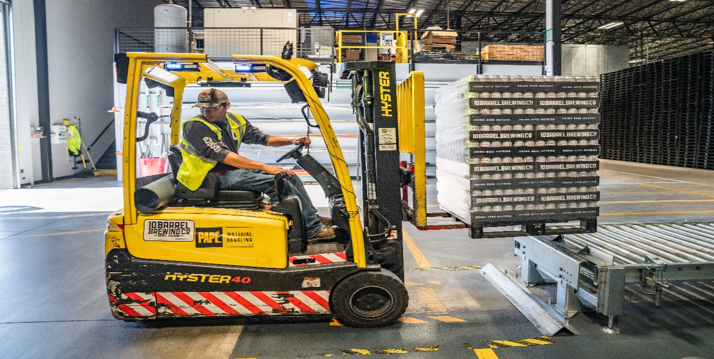

Seventy-six percent of establishments in finance and insurance, employing over 2 million workers, continued to pay some or all employees that were told not to work. That compares with 32 percent of establishments in accommodation and food services. Fifty-four percent of establishments in health care and social assistance, employing almost 8 million workers, continued to pay some or all employees who were told not to work while they were not working. Overall, about 43.5 million employees worked in establishments that paid at least some workers while they were not working.

Slide 9
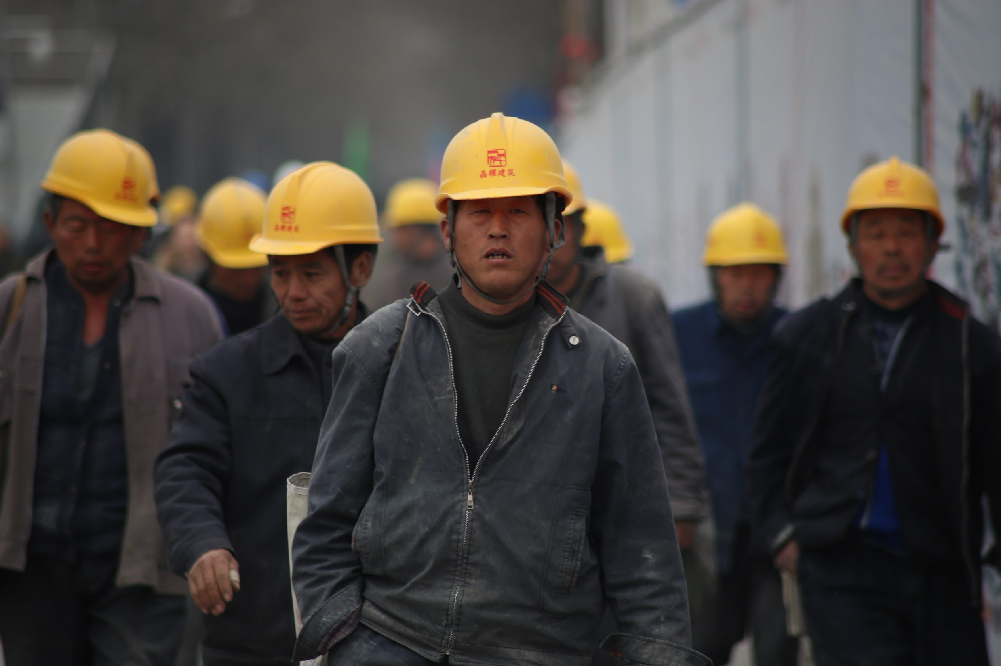

Slide 10

#G116
Thank you!

